Slide 1
Community Roundtable
Mojaloop Open Source Community Meeting #26
15th November 2024

Slide 2
Workstream Governance Guidelines

Slide 3
Workstream Governance Guidelines
Full text on Community Central: https://community.mojaloop.io/workstream-guidelines
Highlights:
Monthly Workstream Leads call replaces quarterly mid-PI review call
Workstream dashboard updated and published monthly
Roadmap updated and published monthly
Workstream Status: Active, Inactive, On Hold, Closed

Slide 4
Contribution Acceptance Guidelines

Slide 5
Contribution Acceptance Guidelines
Full text here. Published this week on Community Central
Highlights:
Product Council:
Checks product-market fit
Benefit to the Mojaloop Ecosystem
Design Authority and Change Control Board:
Mandatory code, design and API reviews
Check for technical debt

Slide 6
Contribution Acceptance Guidelines
Technical Governing Board:
Final decision based on recommendation
Product Council:
Product Backlog
Roadmap development and prioritization
Workstream formation

Slide 7
New Courses for Mojaloop Training Program

Slide 8
Mojaloop Training Program Courses
Two new courses published and launched:
HUB 204: Hub Security Overview
DFSP 204: Mojaloop DFSP Security Overview
Two updated courses
MOJA 101: Mojaloop Introduction
SCHEME 101: Scheme Overview

Slide 9
Updated Documentation

Slide 10
https://docs.mojaloop.io

Slide 11
Community Governance Election

Slide 12
Mojaloop Community Governance Elections
Fri 15.Nov - Fri 22.Nov
0%
Nomination / Register to vote Period
Mon 25.Nov - Fri 6.Dec
Confirmation and slate preparation
Mon 9.Dec - Fri 13.Dec
Voting Period
Mon 16.Dec - Wed 18.Dec
Confirmation period
Wed 18.Dec
Blog announcement of members for each committee
Transition - Committee initial meetings
Mon 6.Jan - Fri 10.Jan
Mojaloop Community Meeting Begins
Thanksgiving Holiday US
Nov 12
Nov 28
2024
2025
11/10
11/17
11/24
12/01
12/08
12/15
12/22
12/29
01/05
Nov 15
Announcement (email and blog)
Nov 20
Reminder
Comms
Dec 9
Voting (sent from Ops)
Dec 11
Reminder (sent from Ops)
Dec 18
Announcement (email and blog)

Slide 13
Gratitude
To the community for a successful PI-25!
To adopters – for great engagement and feedback
To vendors and service providers
Pneuma AV
To one special person for a great service to the mojaloop community…

Slide 14
This person…
Has been involved with Mojaloop since 2016
Was the lead of a Technical Working Committee / Group that worked separately to produce the Mojaloop API in the initial days
Once we had mojaloop reference implementation, he continued as the FSPIOP lead and more recently as the FSPIOP SIG convenor part of the CCB

Slide 15
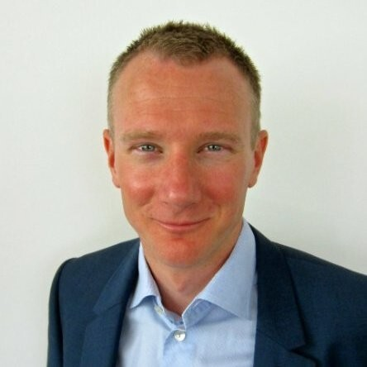
Henrik Karlsson

Slide 16
Thank you
soriko@mojaloop.io

